Slide 1
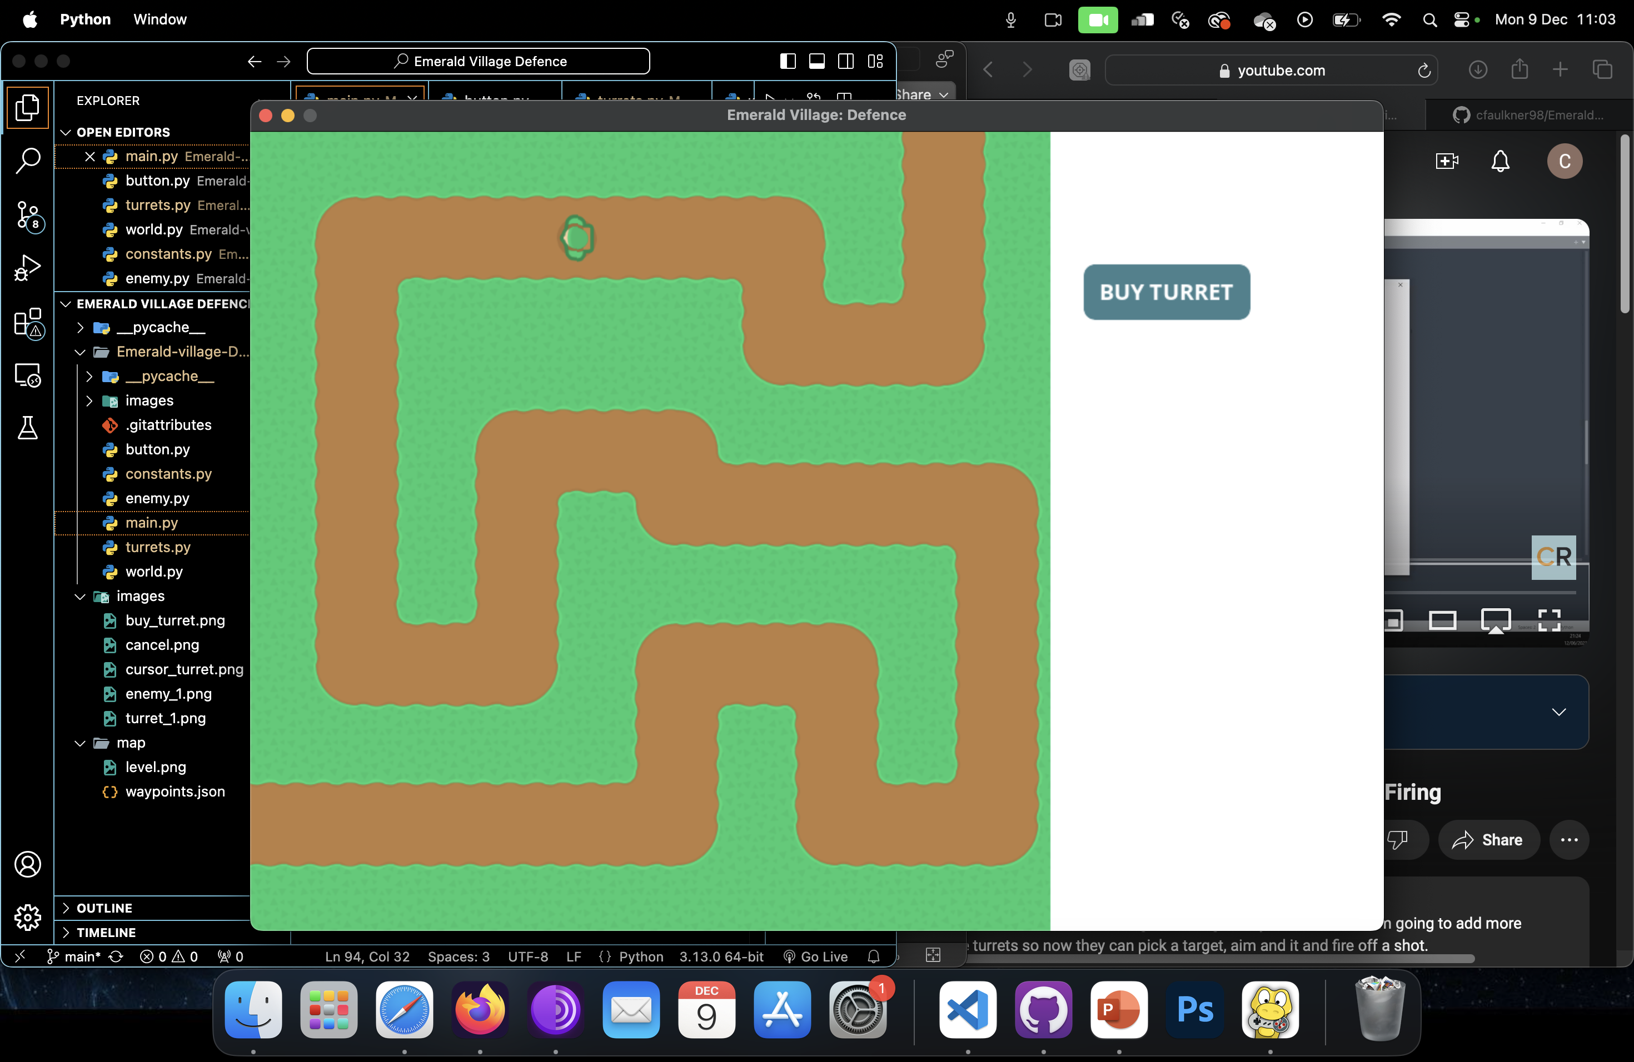
Emerald Village Defense :
By Chloe Faulkner

Slide 2
Introduction
Emerald village is under attack only YOU the player can save the day!
based on battle balloons - tower defense
Characters – turrets (defense), enemy witch
Features – under construction (money, health, upgrading turrets)

Slide 3



design
Used Tiled to create map and add waypoints for the enemy to follow the map
created animation using sprite sheet and inserting that into
the code
Lunapic to scale image of my new enemy

Slide 4
Development – practical elements
Software used – tiled and lunapic
What I've learnt – patience, coding
What I got stuck on – inserting images, correct syntax used,

Slide 5
Evaluation
What I've learnt
How well I've achieved the aim – game still under construction
Features or requirements - animation, sprite sheets, using tiled.

